Slide 1
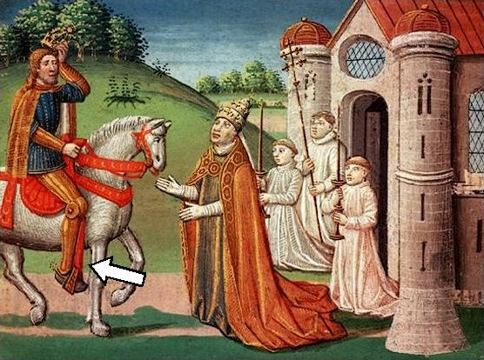
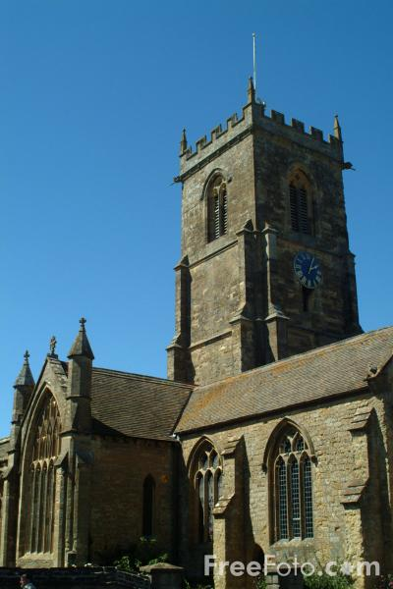
The Early Middle Ages, Part 2 – The Medieval Church

Slide 2
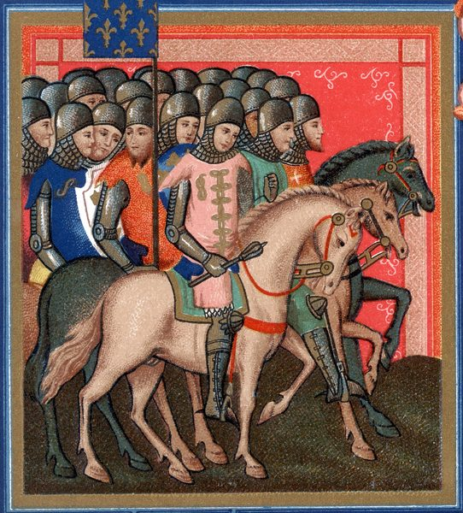
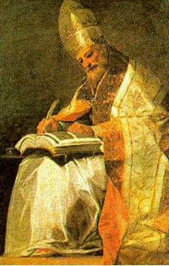
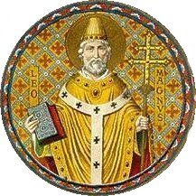
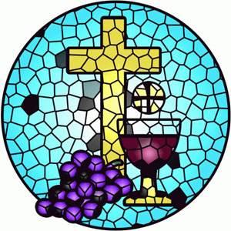
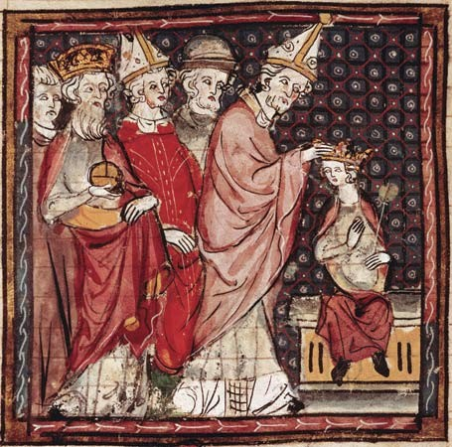
The Church Dominated Medieval Life:
Without one central government the church was the most powerful economic and political entity in Europe.

Slide 3
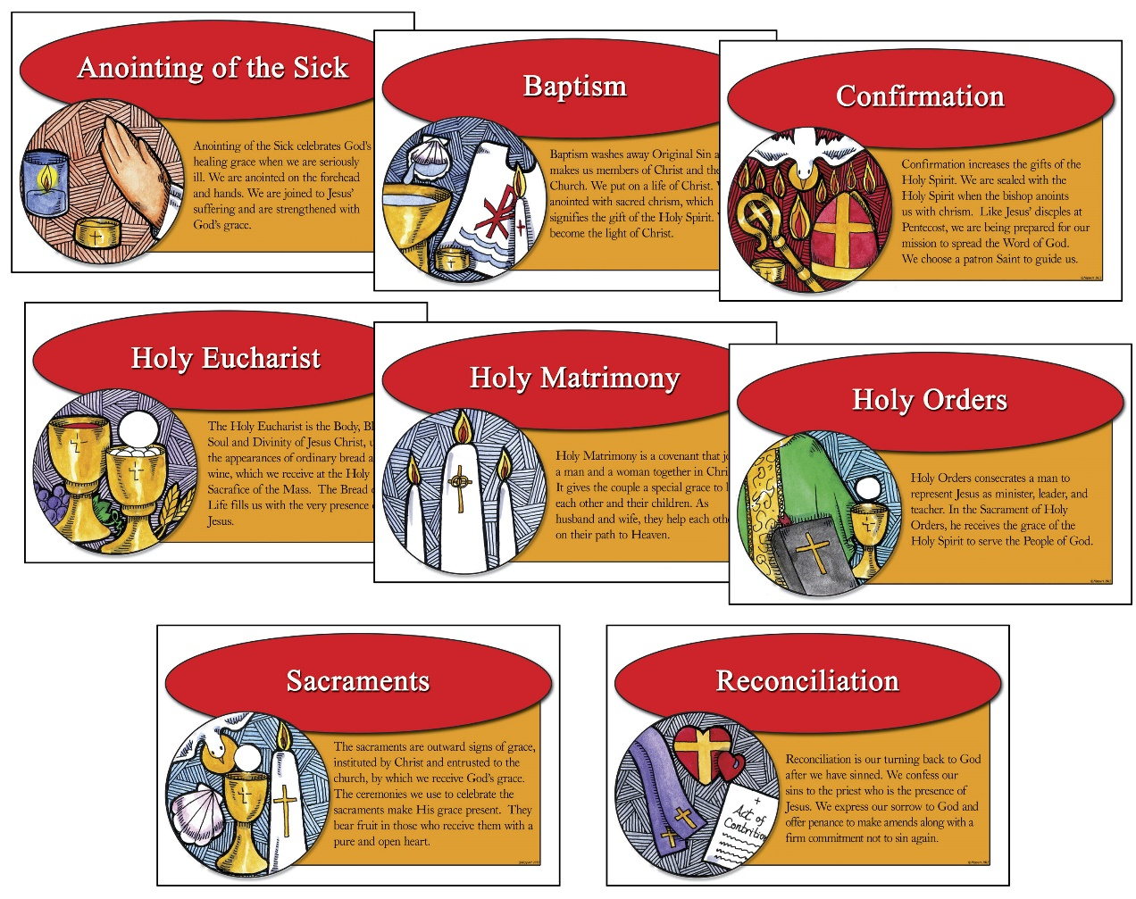
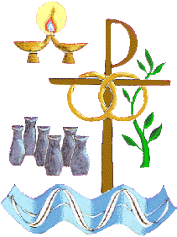
The Church Dominated Medieval Life:
The priests celebrated mass and administered the sacraments – they believed this led to salvation.

Slide 4
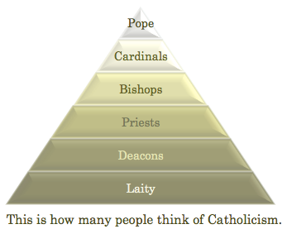
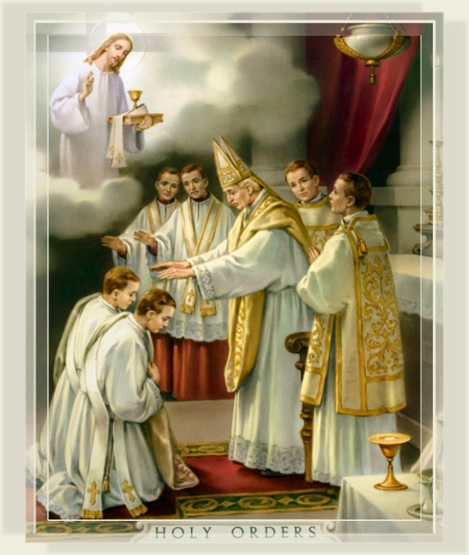
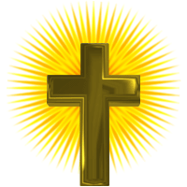
The Sacrament of Holy Orders in the Catholic Church includes three orders: bishop, priest, and deacon.
In the phrase "Holy Orders", the word "holy" simply means "set apart for some purpose.“ Sacred duties.
The Hierarchical Church
You don’t need to write this down

Slide 5
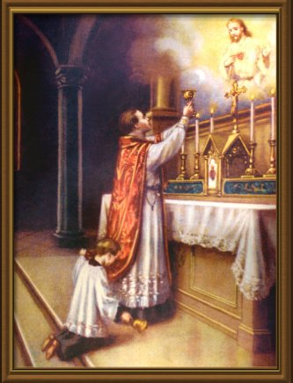
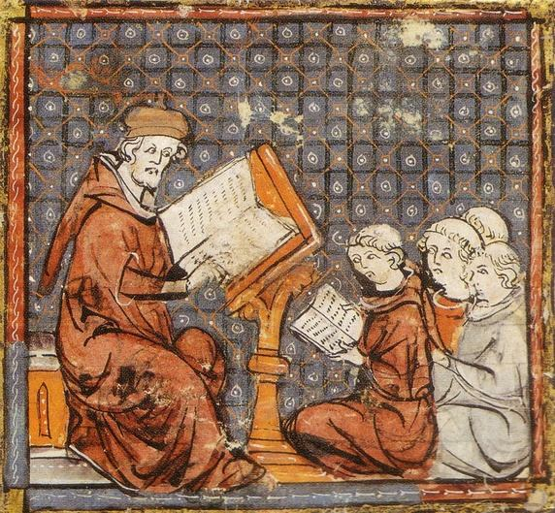
The Church Dominated Medieval Life:
The teachings of the Bible were explained at Mass in Latin only.
Most people could not read.

Slide 6
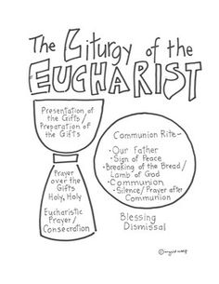
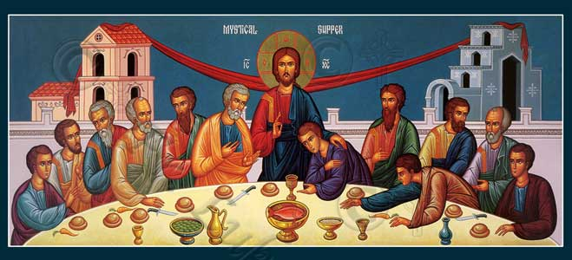
1070 - In the New Testament the word "liturgy" refers not only to the celebration of divine worship but also to the proclamation of the Gospel and to active charity.
The Liturgy of Mass is the order of mass
You don’t need to write this down

Slide 7
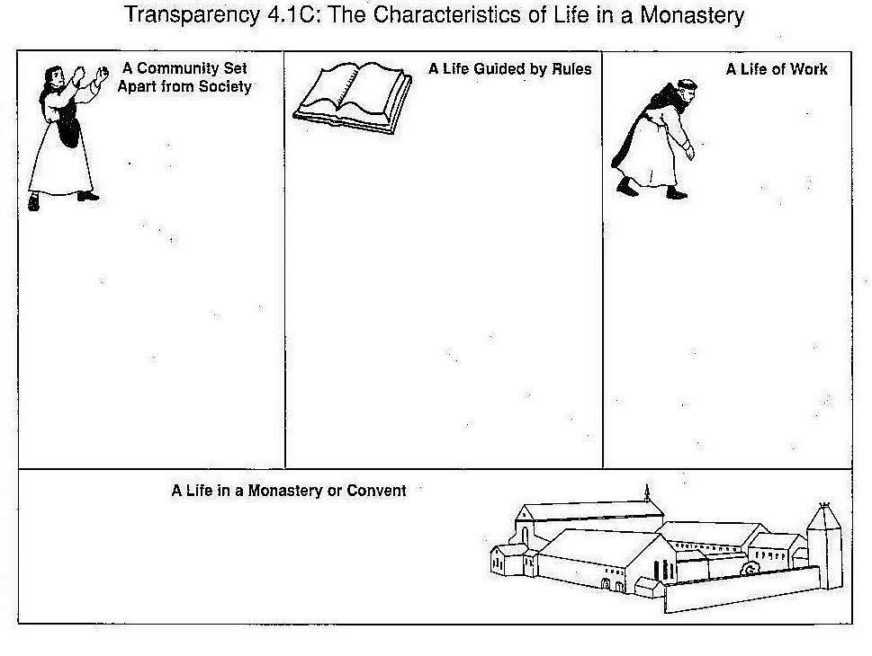
Around the 300 and 400s many Catholic priests became monks
Emphasis on hard work and prayer
Soon, the monastic life became a communal lifestyle
Self-sufficient & Charitable Tasks
MONK = Someone who lives alone -
THE BENEDICTINE RULE ---St. Benedict of Nutria, Italy, wrote between 520 and 530 rules for monks to live by
Hospitals, orphanages, food for poor, lodging, as well as mission work
Sought a life separate from human society – dedicated to God and to help others
Saint Patrick converted Ireland to Christianity in the 400s. He set up many monasteries
Women also joined the monasteries as nuns
Headed by Abbot (monks) or Abbess (nuns)
Monks and Nuns were the main force of conversions to Catholicism in Europe

Slide 8
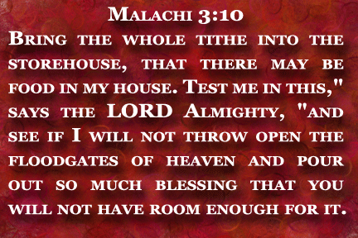
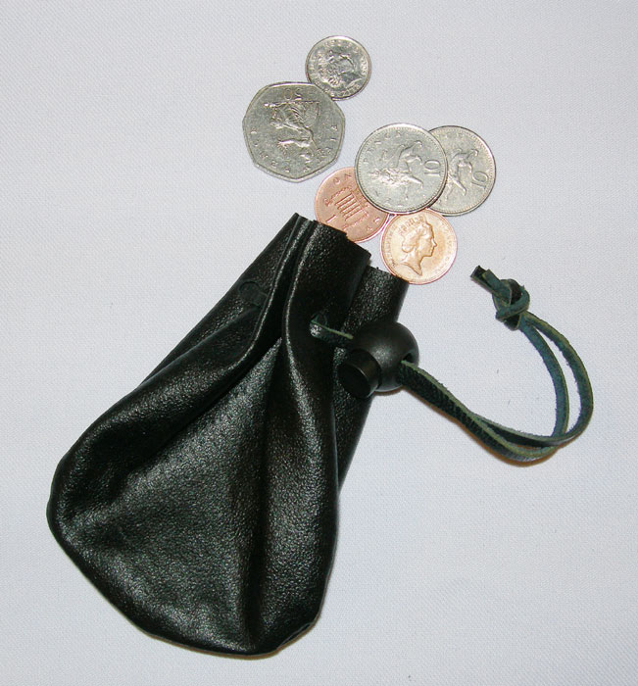
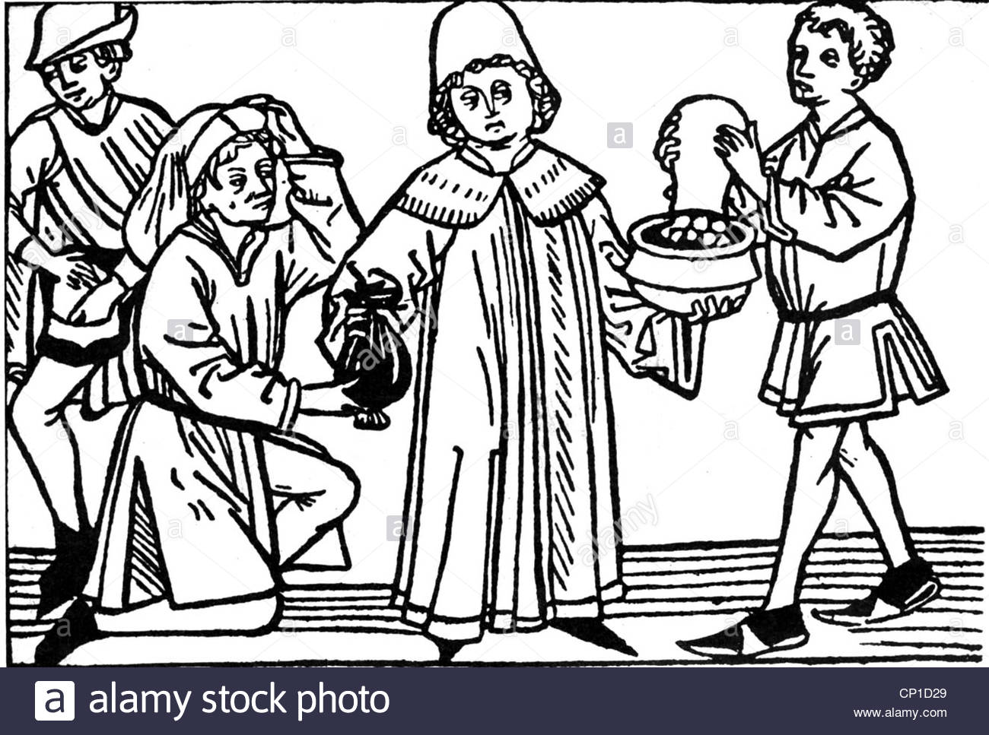
The church required all Christians to pay a tithe (like a tax) of ten percent of their income.

Slide 9
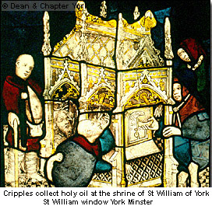
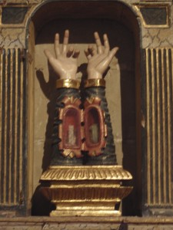
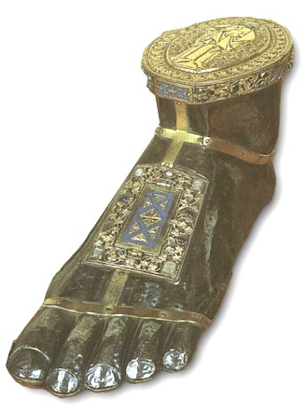
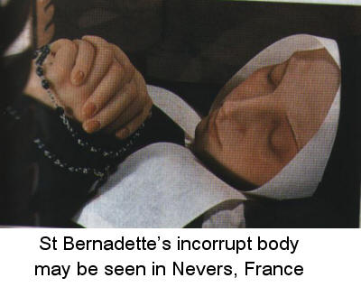
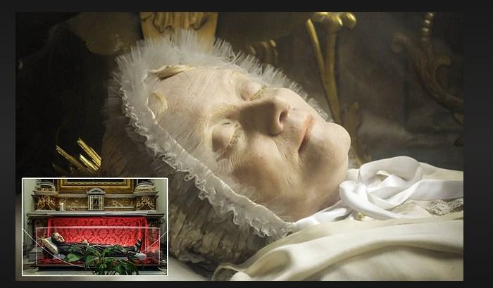
Foot of a Saint
You don’t need to write this down
Some churches housed relics.
Pilgrimages would be made to pray to the relics for blessings.
The Pilgrims would make offerings - churches could get rich

Slide 10
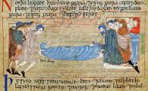
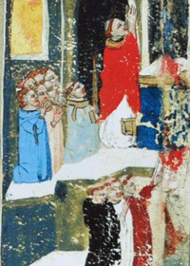
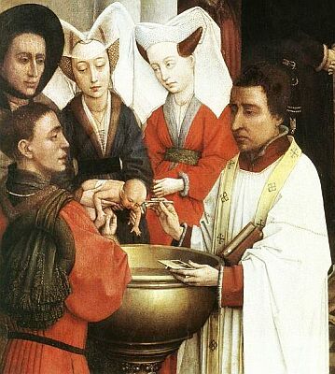
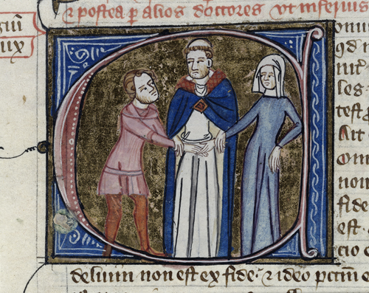
Religion shaped the everyday lives of Christian Europeans.
The Village Church was a place of worship and the social center.
Gather for baptisms, weddings and burials.

Slide 11
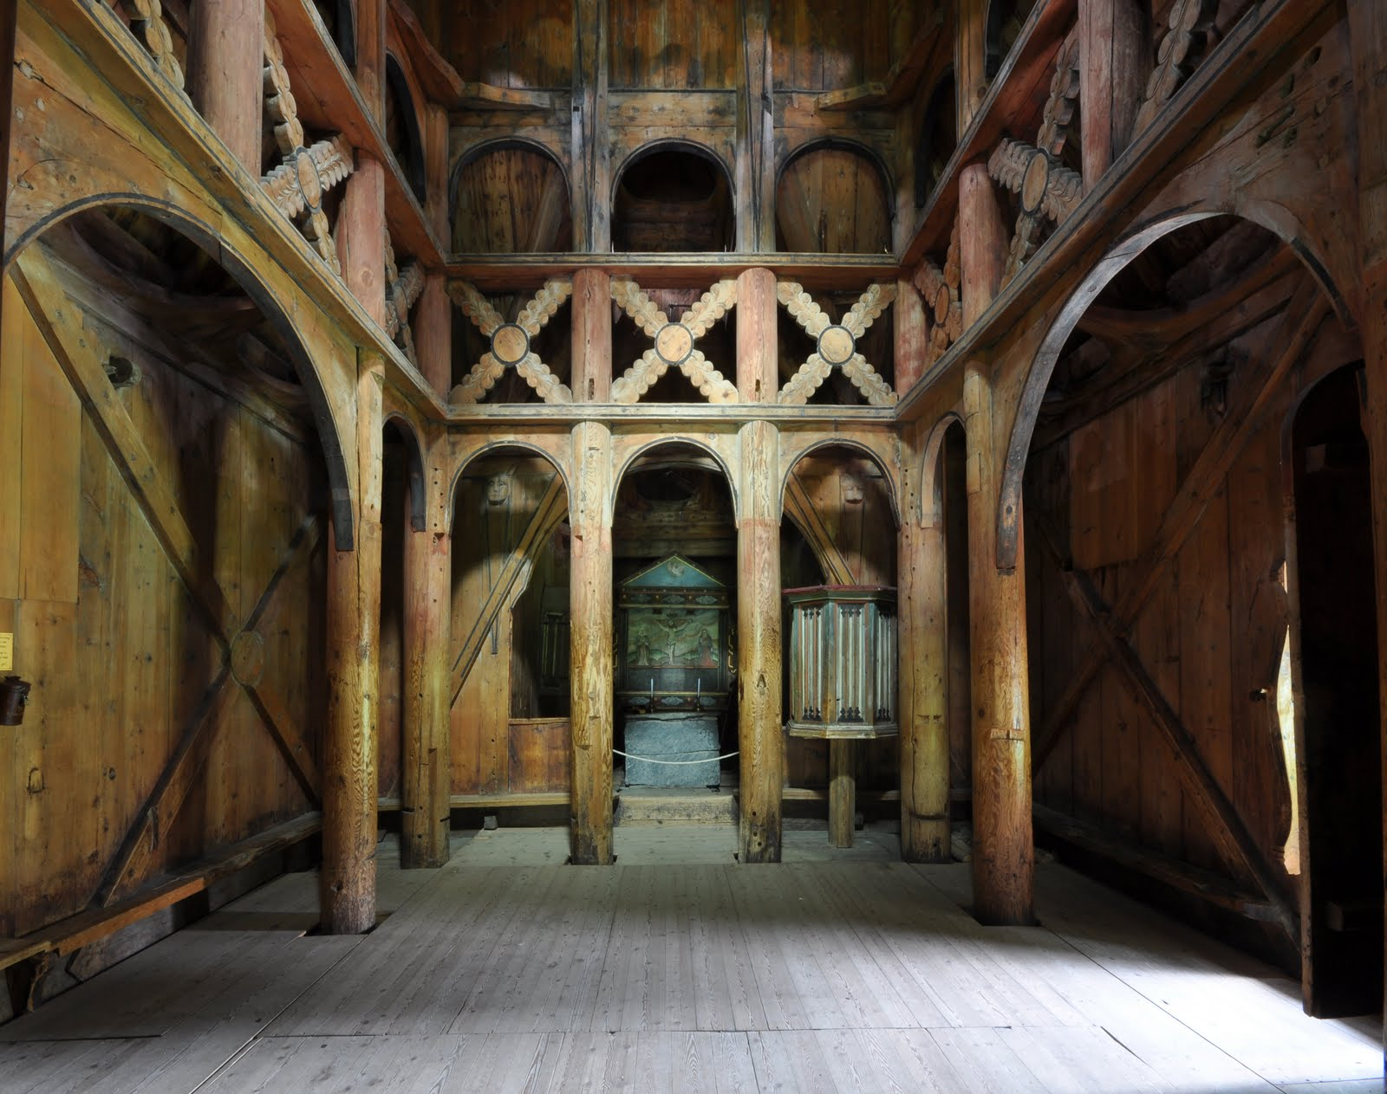
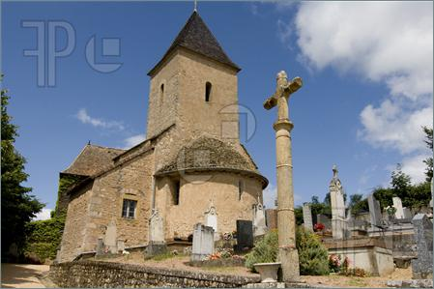
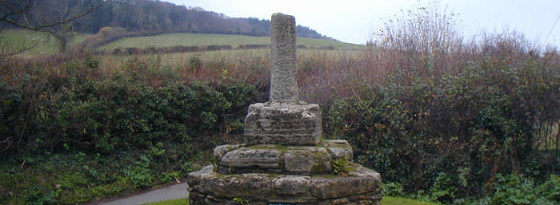
Most village churches were built of wood
You don’t need to write this down
Wealthier communities built their churches of stone.

Slide 12
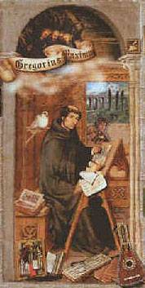
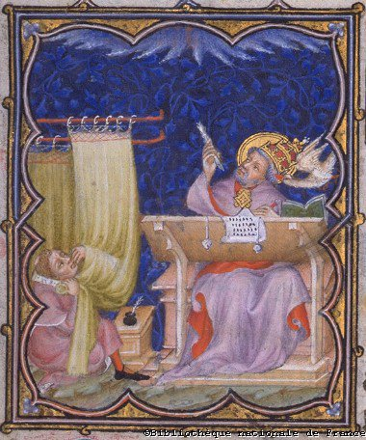
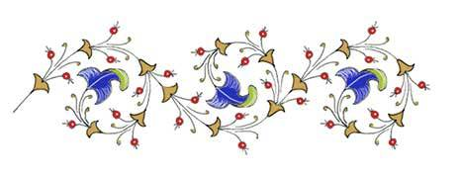
The Bishop of Rome, THE POPE, was considered the representative of Christ on Earth.
PAPAL SUPREMACY was not fully recognized until Pope Gregory I, known as Saint Gregory The Great.
He was Pope from 590–640 A.D.

Slide 13
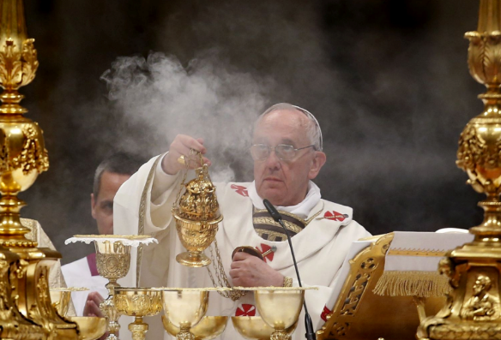
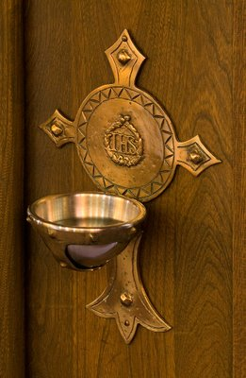
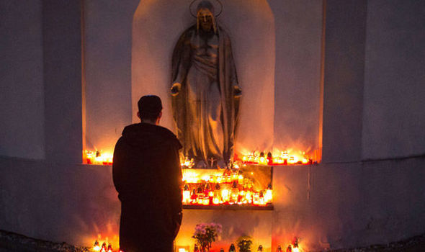
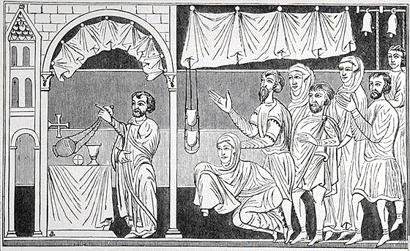
To get the Pagan Anglo Saxons to convert, Pope Gregory absorbed some pagan customs into Christianity
But what really matters is what you believe you are celebrating in your heart
In his 1878 Essay on the Development of the Christian Doctrine John H. Newman wrote:
"The use of temples, dedicated to saints - ornamented on occasions with branches of trees; incense; votive offerings on recovery from illness; holy water; holy days and seasons, processions, the ring in marriage, the ecclesiastical chant, are all of pagan origin, and sanctified by their adoption into the Church."

Slide 14
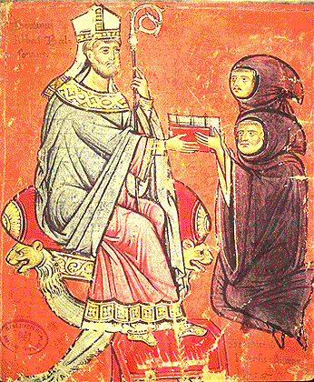
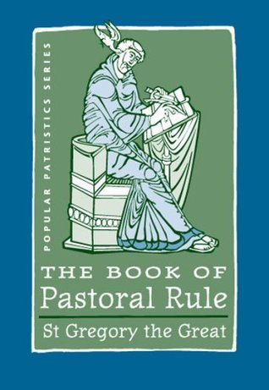
He revised the Sacraments and liturgy of the Mass,
He introduced chants in the Mass which would become the Gregorian Chant by the 900s
He mandated “alms for the poor” – to relieve the distress of the hungry and destitute
He was considered by many to be one of the kindest and most caring Popes in past history; John Calvin, a Christian reformer from the 1500s, said he was “the last good Pope.”
Like a shepherd caring for his sheep, we are to care for one another

Slide 15
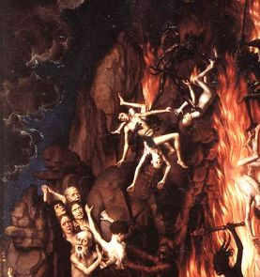
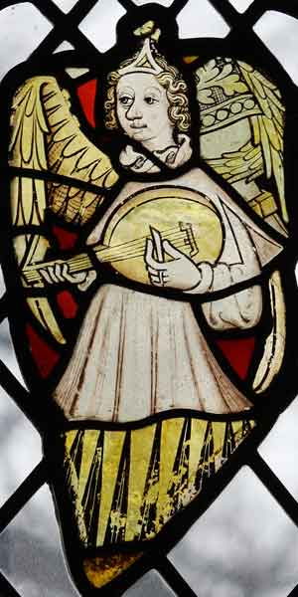
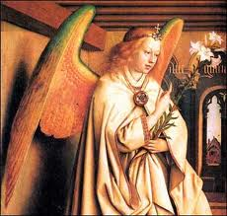
Medieval Christians were taught that they were all sinners and many were doomed to the tortures of hell.
By doing good deeds, paying their tithes, attending Mass and taking of the sacraments they could avoid hell and might be able to go to heaven

Slide 16
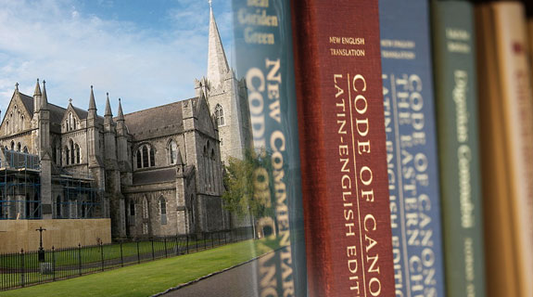
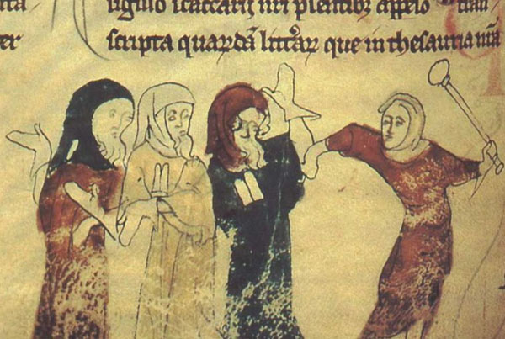
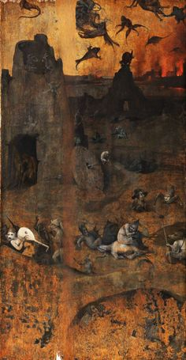
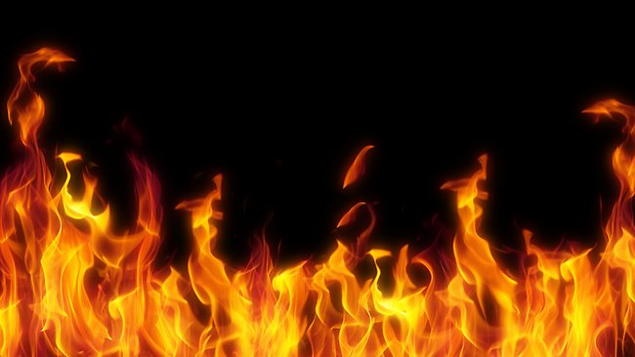
The body of laws to follow were known as Canon Law.
If you did not follow the rules you could get excommunicated – kicked out of the church = go to hell ☹

Slide 17
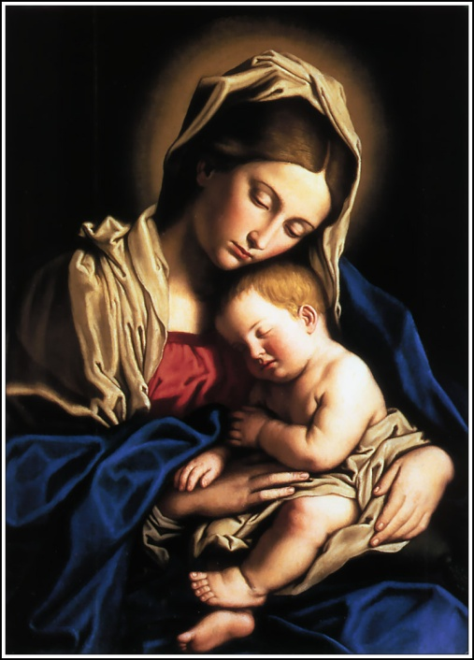
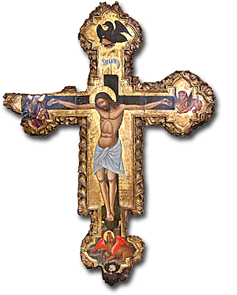
The Church and Women
Church doctrine taught that men and women were equal before God.
BUT – on Earth women were treated as weak and easily led into sin.
Women were to model themselves after the pure and modest mother of Jesus, Mary “Queen of the Universe.”
Women were allowed to enter convents and become nuns – but were not allowed to preach .

Slide 18
A Force for Peace:
The church wanted to use its power to end warfare amongst nobles.
It declared temporary peace called the Truce of God.
Fighting was to stop Friday through Sunday.
This did reduce warfare in the 1100s.

Slide 19
Jews in Medieval Europe
In early Middle Ages Jews lived all across Europe
Spain became the center of Jewish culture because Islamic rulers were tolerant of the Jews & Christians; many Jews served as officials in Royal Court.

Slide 20
late 1100s when Europe became more Christianized prejudice against Jews increased.
disasters like famine or plagues - they would blame the Jews and punish or kill them.
Many areas began to forbid Jews from living in them.
Many Jews moved to Eastern Europe where they found tolerance and prosperity.

